Slide 1
Intelligence Business Solutions Vietnam
- Training [When we receive a task, what should we do?] –
18th December 2014
Công Ty TNHH Giải Pháp Kinh Doanh Intelligence Việt Nam

Slide 2

～When you receive a task, what should we do?～
When you receive a task, first of all, what do you do?
You start to work right away.
You ask a question.
etc…

Slide 3
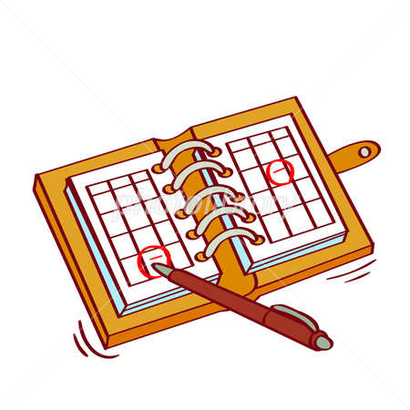
1.Check the deadline
～When you receive a task, what should we do?～
If you finish the task before the deadline, you can gain the trust of your colleague, your manager

Slide 4

2. Make clear the meaning of task
～When you receive a task, what should we do?～
- People who give you a task don’t often make clear the meaning of task.
- Because they don’t have enough time so they ask you.
- That‘s why, you need to talk with them, then, you need to make clear the meaning of task
-If you can make clear your task, 50% of your task will finish.
e.g. copy documents

Slide 5
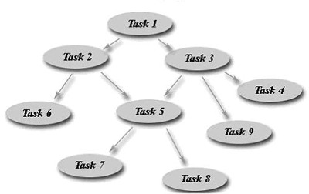
3. Divide task
～When you receive a task, what should we do ? ～
A task that you were asked looks like a big rock.
It’s difficult to do a task as it is.
When you make a schedule for a task, and need other’s help, you need to divide it to multi small tasks.

Slide 6

4. Start the difficult task first
～When you receive a task, what should we do ? ～
When you do a difficult task, it takes a long time.
It’s not easy to estimate the finished time. So, when the deadline is approaching, maybe your task will be delayed.

Slide 7
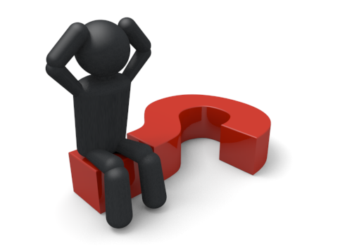
5. If you can’t finish a task on time, report it to your supervisor immediately
～When you receive a task, what should we do ? ～
There is a possibility that people who entrust the work don’t know whole the work. It means maybe there is an impossible task.
In this case, consult with them immediately. It’s a waste of time.

Slide 8

6. Don’t think without using precedents.
～When you receive a task, what should we do ? ～
In the company, there are similar tasks. It’s a waste of time to think by only yourself.

Slide 9

7. You need to achieve accountability
～When you receive a task, what should we do ? ～
People who entrust a task is always worrying about the progress of your work.
At that time, please explain it simply and correctly. This will relieve their stress.
If your explanation is easy to understand, you can gain a person’s confidence.

Slide 10
8. If you have any tasks that needs other’s help, ask them for help as soon as possible. Then, tell 1～7 to them.
～When you receive a task, what should we do ? ～
Basically, your work needs other’s help.

Slide 11

～When you receive a task, what should we do ? ～
Thank you for your attention.

